Slide 1
Chapter 2
Building Your
First React App

Slide 2
Objectives
Dealing with JSX
Getting Your React On
Displaying Your Name
It’s All Still Familiar

Slide 3
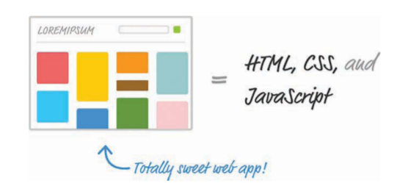
Dealing with JSX
Besides normal HTML, CSS, and
JavaScript. JSX is a language that allows you to easily mix JavaScript and HTML-like tags to define user interface (UI) elements and their functionality. That sounds cool and all(and you’ll see JSX in action in just a few moments), but there’s a slight problem. Your browser has no idea what to do with JSX.

Slide 4
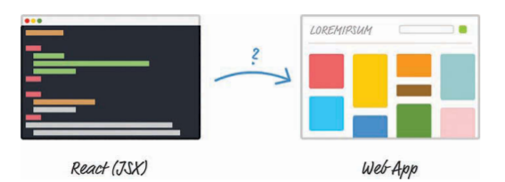
Dealing with JSX
To build a web app using React, we need a way to convert our JSX into plain old JavaScript that your browser can understand

Slide 5
Dealing with JSX
If we don’t do this, our React app simply won’t work. That’s not cool. Fortunately, we have two solutions to this:
1. Set up a development environment around Node and a handful of build-tools. In this environment, every time you perform a build, all of your JSX is automatically converted into JS and placed on disk for you to reference like any plain JavaScript file.
2. Let your browser automatically convert JSX to JavaScript at runtime. You specify your JSX directly, just as you would any old piece of JavaScript, and your browser takes care of the rest.

Slide 6
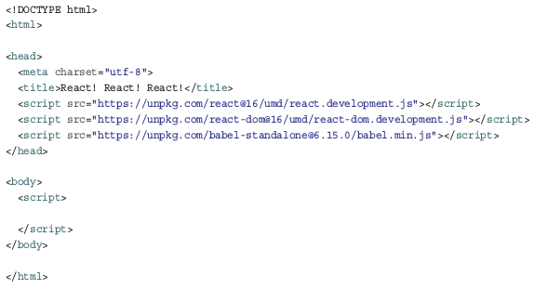
Getting Your React On
Create a new HTML document with the following contents:

Slide 7
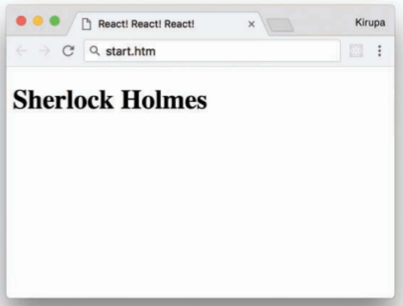
Displaying Your Name
You do that is by setting the type attribute on the script tag to a value of text/babel :
The render method takes two arguments:
The HTML-like elements (a.k.a. JSX) you want to output
The location in the DOM where React will render the JSX into
<script type="text/babel"> ReactDOM.render( <h1>Sherlock Holmes</h1>, document.body ); </script>

Slide 8
It’s All Still Familiar
To make this happen, go back to the HTML and add a div
element with an id value of container :
<body> <div id="container"></div> <script type="text/babel"> ReactDOM.render( <h1>Batman</h1>, document.body ); </script> </body>
Another option is to do some things outside the render method itself: var destination = document.querySelector("#container"); ReactDOM.render( <h1>Batman</h1>, destination );

Slide 9
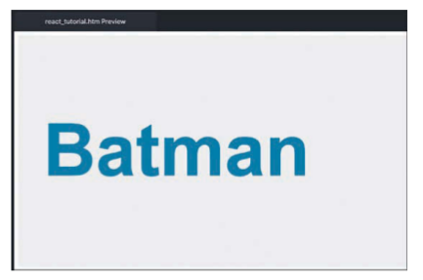
Styling It Up!
That’s just terrible, so let’s fix that by adding some CSS.
Inside your head tag, let’s add a style block with the following CSS:
<style> #container { padding: 50px; background-color: #EEE; } #container h1 { font-size: 144px; font-family: sans-serif; color: #0080A8; } </style>

Slide 10
Conclusion
If this is your first time building a React app, we covered a lot of ground here. One of the biggest takeaways is that React is different than other libraries because it uses a whole new language called JSX to define what the visuals will look like.
Another approach (the one we used here) is to use the Babel library to translate the JSX into JavaScript on the browser itself. While the performance hit of doing this is not recommended for live/production apps, when you’re familiarizing yourself with React, you can’t beat the convenience.
Note: If you run into any issues, ask! If you have any questions or your code isn’t running like you expect, don’t hesitate to ask! Post on the forums at https://forum.kirupa.com and get help from some of the friendliest and most knowledgeable people the Internet has ever brought together!

